Slide 1
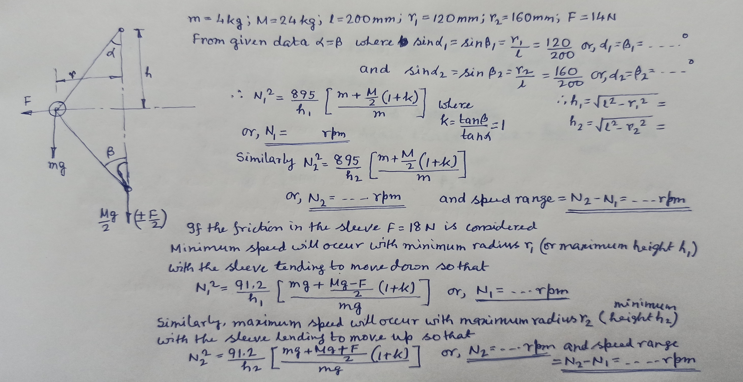
Problems on Governor

Slide 2
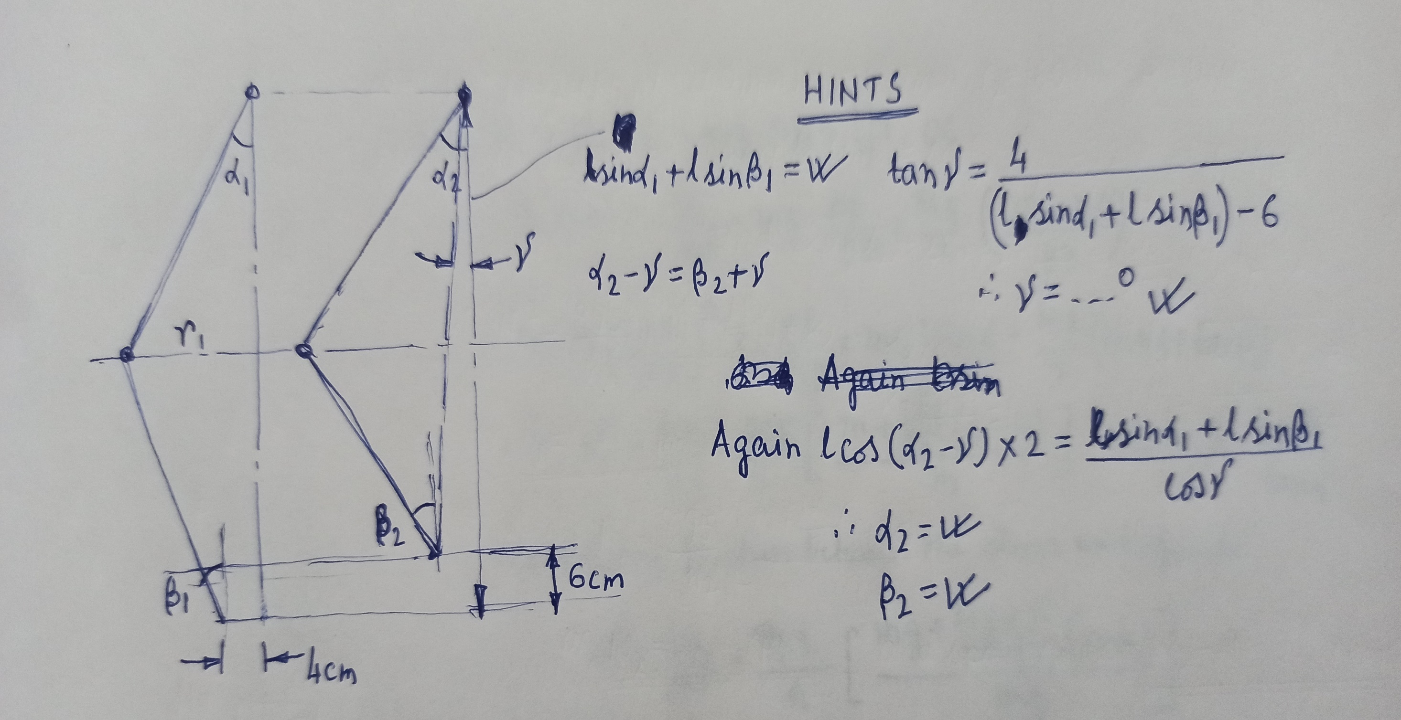
Problems on Governor

Slide 3
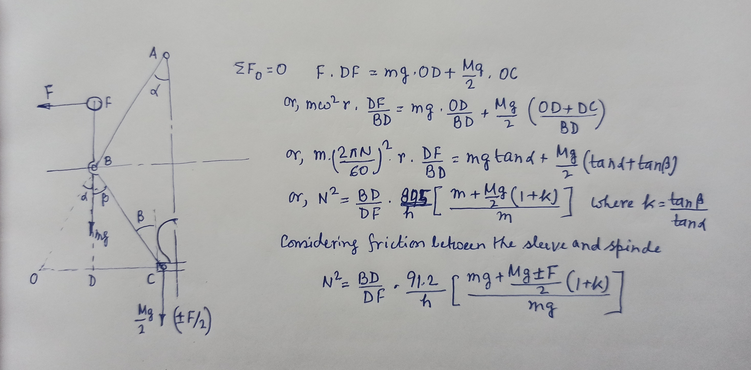
Proell Governor

Slide 4
Problems on Proell Governor
A proell governor has arms of 300 mm length. The upper arms are hinged on the axis of rotation whereas the lower arms are pivoted at a distance of 35 mm from the axis of rotation. The extensions of the lower arms to which the balls are attached are 100 mm long. The masses of the ball and the sleeve are 8 kg and 60 kg respectively. At the minimum radius of rotation of 200 mm the extensions are parallel to the governor axis. Determine the equilibrium speed of the governor for the given configuration. What will be the equilibrium speed for the maximum radius of 250 mm?
A proell governor with arms of 220 mm length are pivoted at an offset of 20 mm from the axis of rotation. For the mid-position of the sleeve the extension links of the lower arms are vertical, the height of the governor is 180 mm and the speed is 150 rpm. The masses of the ball and the sleeve are 3 kg and 20 kg respectively. Determine the length of the extension links and the tension in the upper arms. What will be the speed range for the given configuration if a friction of 20 N is assumed in between the sleeve and the spindle?

